Slide 1
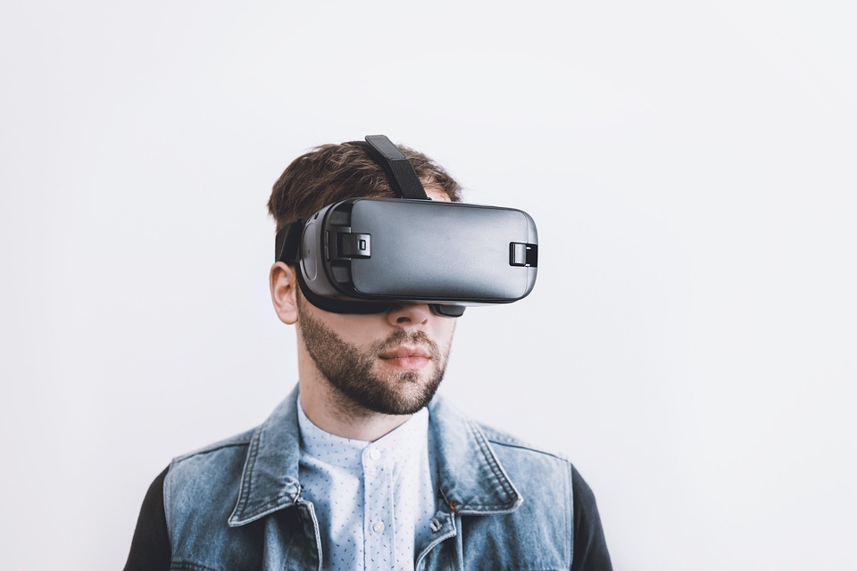
MTSweepers VR
Presented by Virtual Escape

Slide 2
Who Are We??
Saman Kittani, Noah Smith, Nash Hearn, Daniel Nuthalapaty, Jordan Cormier, Joseph Saunderson, Levi Driver, Yesenia Baltazar, Aaron Sadler, Soma Ezzadpanah, Forrest Cutrell, Tyler Nguyen, Quinton Smith
~Team Virtual Escape is composed entirely of college students that share a common interest: innovation through technology. Using our knowledge and creativity, as a team, we split up tasks to recreate a classic game using modern technology.

Slide 3
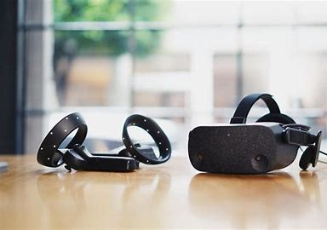
What is Virtual Reality (VR)?
~ VR is “computer generated environments or realities that are designed to simulate a person’s physical presence in a specific environment that is designed to feel real. (techopedia)”
~ Virtual Reality surprisingly dates back to 1957 by Morton Heilig, however, with technology continually on the rise it is huge in today's society
~ VR simulate reality through the use of interactive devices, which can be worn as goggles, headsets, gloves, or body suits

Slide 4
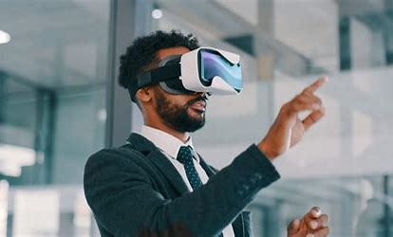
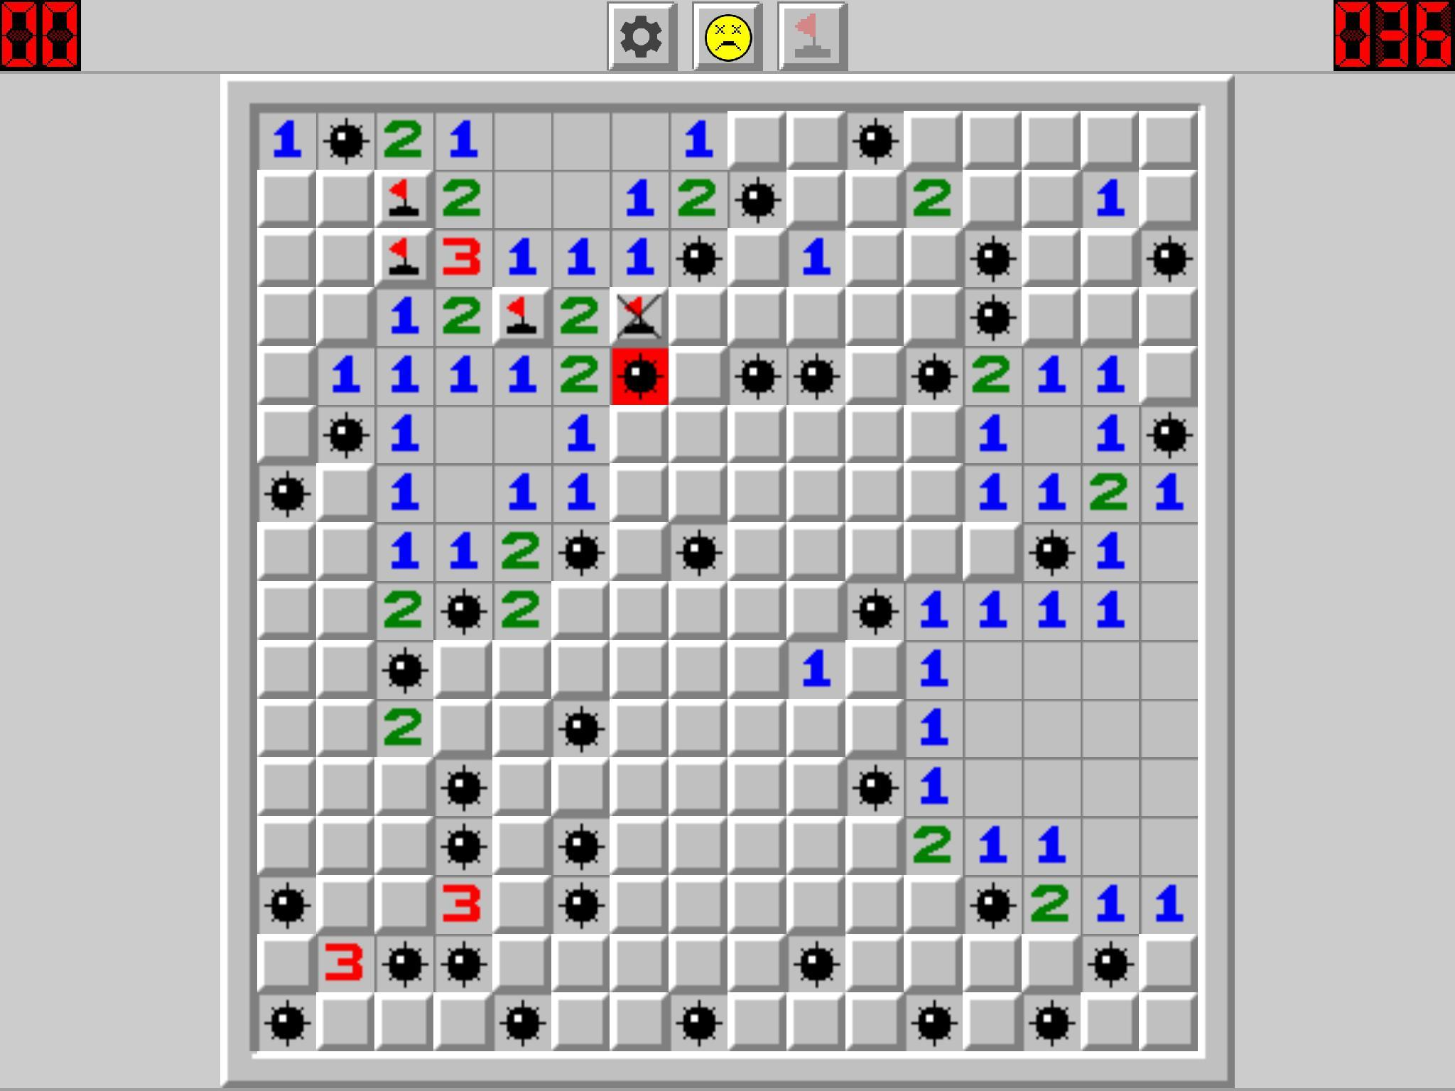
Our Goal
~To make a virtual reality version of the game Minesweeper with additional objectives and a unique experience
==

Slide 5
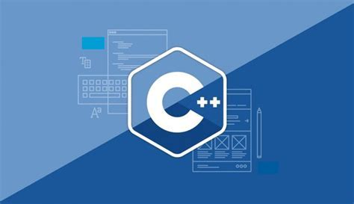



Stack that we used….
~The majority of the game is created in Unreal Engine
~Assets were created and imported using Blender 3D modeling
~Languages used to code in the game mechanics were C++
~To finish it all off, our music production was made possible thanks to FL Studio

Slide 6
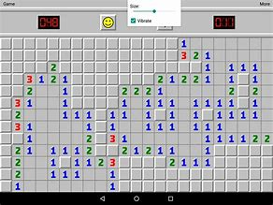
What is MTSweepers VR?
~ MTSweepers is our take on this classic game.
~The biggest difference between Minesweepers and MTSweepers is the use of Virtual Reality.
~ Therefore, you get to play Minesweepers in a first person view through your choice of three different levels, easy, medium or hard.
MINESWEEPERS

Slide 7

Things we’ve learned
~Not only have we become more familiar with the software and languages used to make this possible, we've also learned to coordinate our efforts to meet certain goals and find solutions to problems more effectively

Slide 8
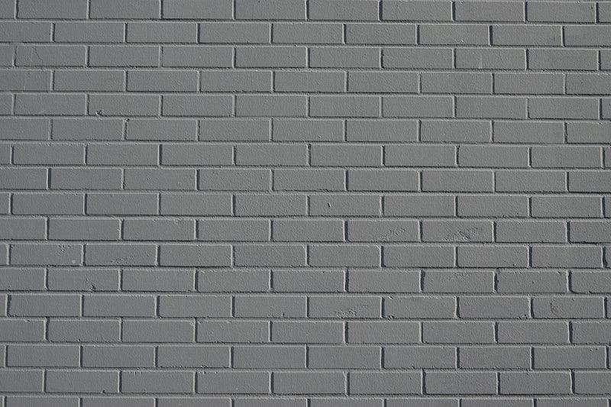
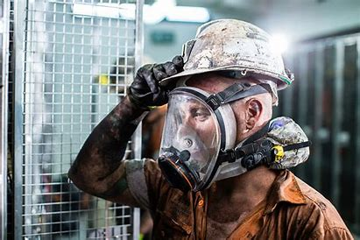
Time to Sweep for mines

